Slide 1
Convolutional Neural Networks
Radu Ionescu, Prof. PhD.
raducu.ionescu@gmail.com
Faculty of Mathematics and Computer Science
University of Bucharest

Slide 2
Plan for Today
CNNs
Notation
Convolutions
Architecture
Case studies

Slide 3


Multilayer Networks
Cascade Neurons together
The output from one layer is the input to the next
Each layer has its own sets of weights

Slide 4
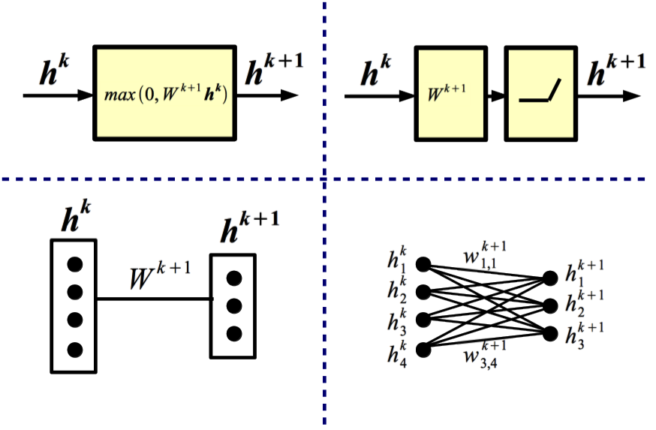
Equivalent Representations

Slide 5
Backward Propagation
Question: Does BPROP work with ReLU layers only?
Answer: Nope, any almost anywhere differentiable transformation works.
Question: What's the computational cost of BPROP?
Answer: About twice FPROP (need to compute gradients w.r.t. input and parameters at every layer).
Note: FPROP and BPROP are dual of each other. E.g.,:
FPROP
BPROP
SUM
+
COPY
+

Slide 6
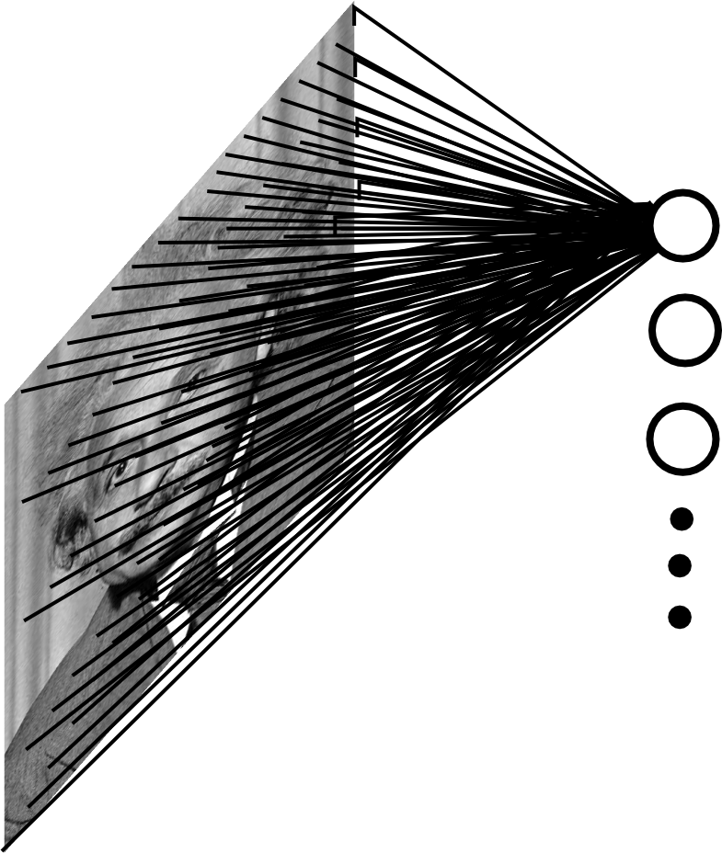
Fully Connected Layer
Example: 200x200 image
40K hidden units
~2B parameters!!!
- Spatial correlation is local
- Waste of resources + we have not enough training samples anyway..

Slide 7
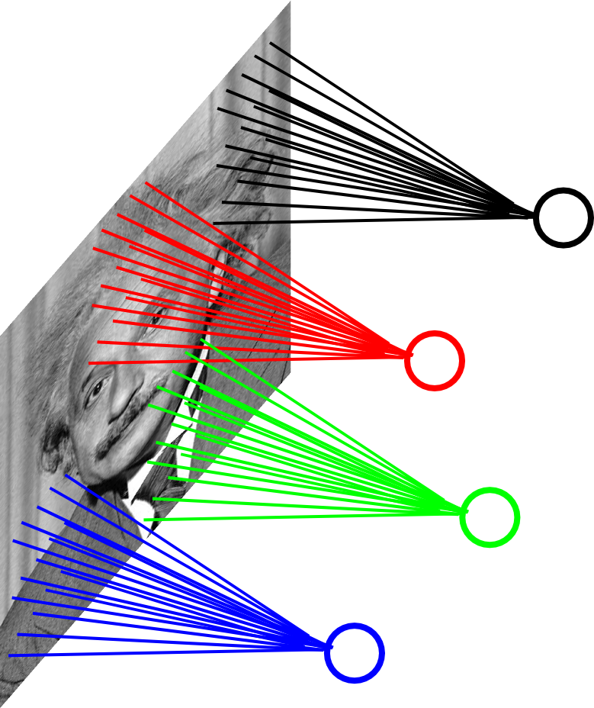
Locally Connected Layer
Example: 200x200 image
40K hidden units
Filter size: 10x10
4M parameters
Note: This parameterization is good when input image is registered (e.g., face recognition).

Slide 8
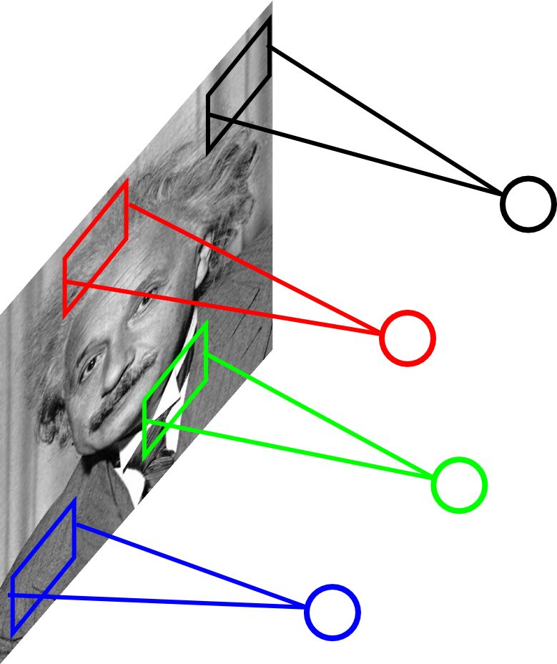
Locally Connected Layer
STATIONARITY? Statistics is similar at different locations
Example: 200x200 image
40K hidden units
Filter size: 10x10
4M parameters
Note: This parameterization is good when input image is registered (e.g., face recognition).

Slide 9
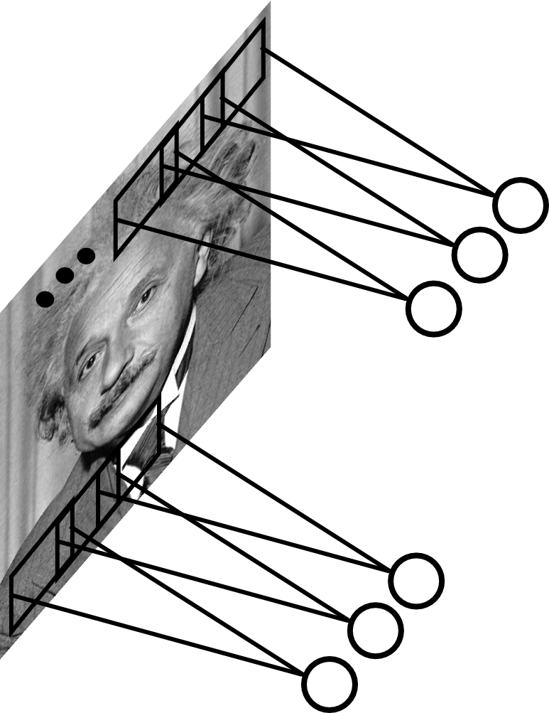
Convolutional Layer
Share the same parameters across different locations (assuming input is stationary):
Convolutions with learned kernels

Slide 10


Maximum activation = highest response
https://commons.wikimedia.org/wiki/File:Convolution_of_box_signal_with_itself.gif

Slide 11
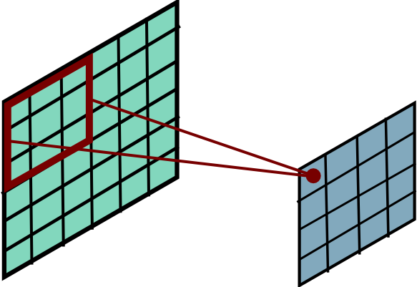
Convolutional Layer
Slide Credit: MarcAurelio Ranzato

Slide 12
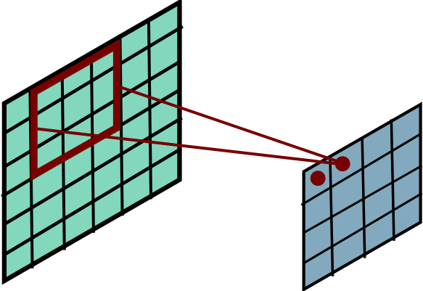
Convolutional Layer
Slide Credit: Marc'Aurelio Ranzato

Slide 13
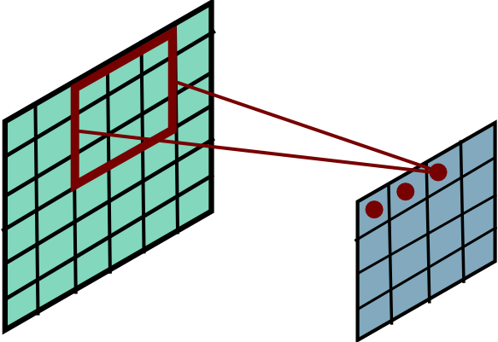
Convolutional Layer
Slide Credit: Marc'Aurelio Ranzato

Slide 14
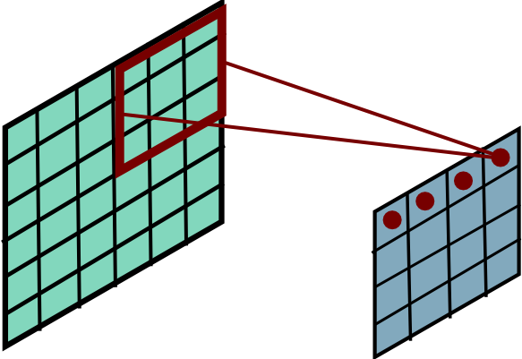
Convolutional Layer
Slide Credit: Marc'Aurelio Ranzato

Slide 15
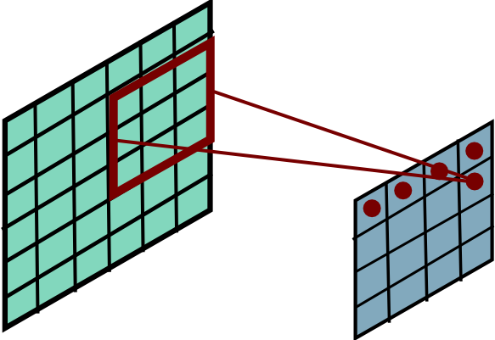
Convolutional Layer
Slide Credit: Marc'Aurelio Ranzato

Slide 16
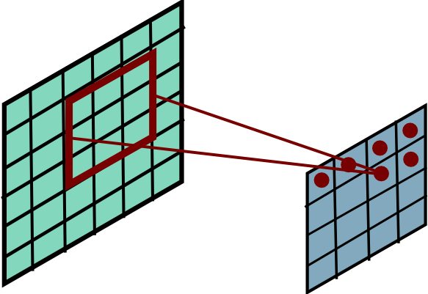
Convolutional Layer
Slide Credit: Marc'Aurelio Ranzato

Slide 17
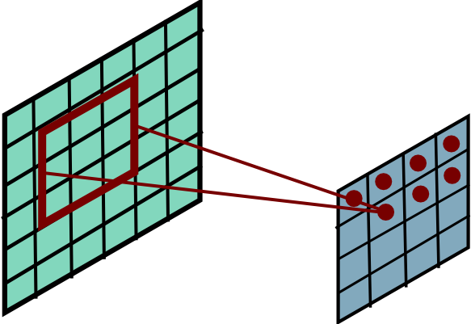
Convolutional Layer
Slide Credit: Marc'Aurelio Ranzato

Slide 18
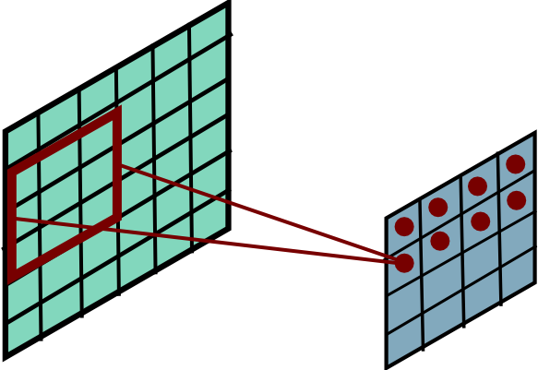
Convolutional Layer
Slide Credit: Marc'Aurelio Ranzato

Slide 19
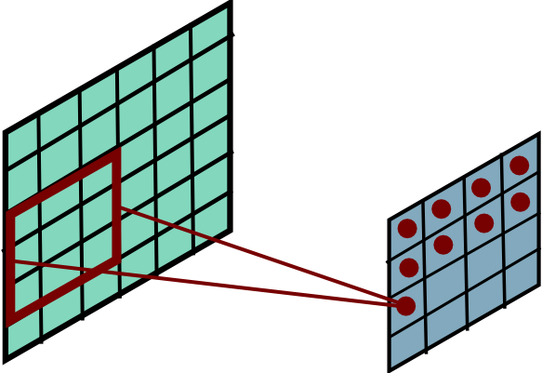
Convolutional Layer
Slide Credit: Marc'Aurelio Ranzato

Slide 20
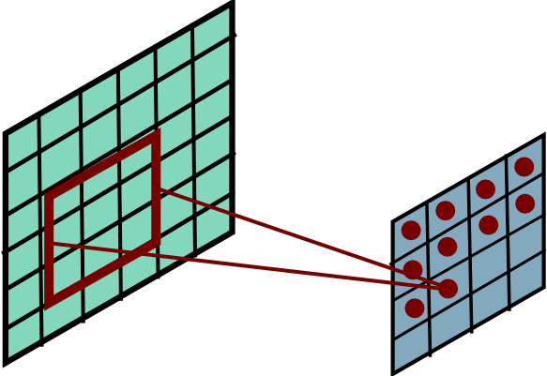
Convolutional Layer
Slide Credit: Marc'Aurelio Ranzato

Slide 21
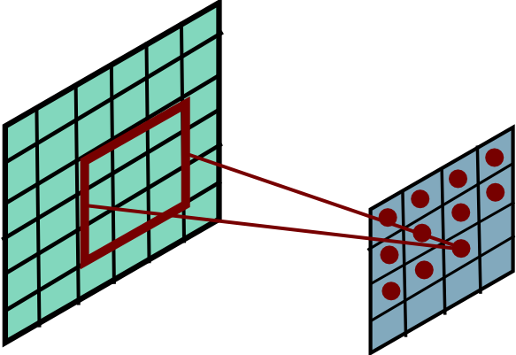
Convolutional Layer
Slide Credit: Marc'Aurelio Ranzato

Slide 22
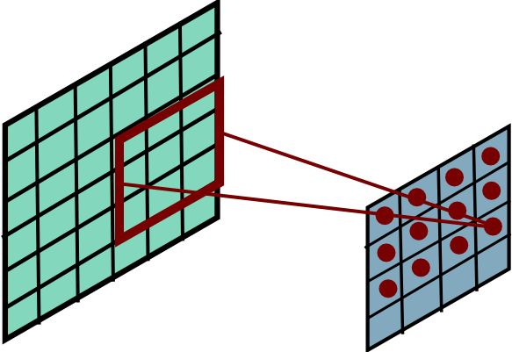
Convolutional Layer
Slide Credit: Marc'Aurelio Ranzato

Slide 23
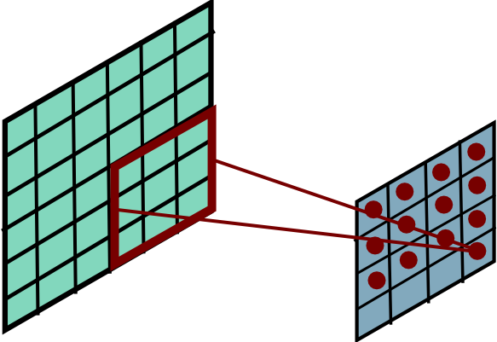
Convolutional Layer
Slide Credit: Marc'Aurelio Ranzato

Slide 24
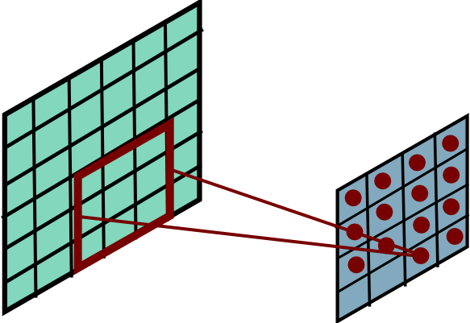
Convolutional Layer
Slide Credit: Marc'Aurelio Ranzato

Slide 25
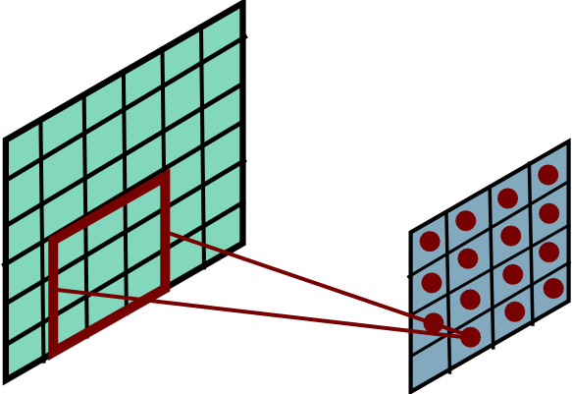
Convolutional Layer
Slide Credit: Marc'Aurelio Ranzato

Slide 26
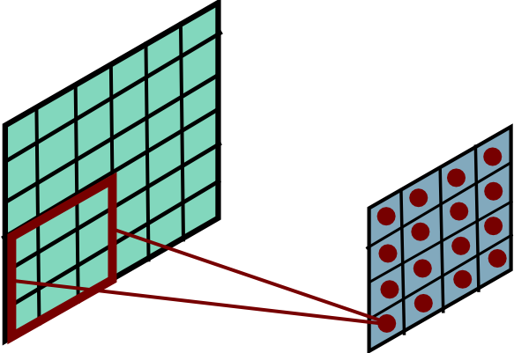
Convolutional Layer
Slide Credit: Marc'Aurelio Ranzato

Slide 27
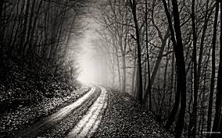
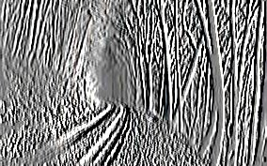
Convolutional Layer
-1 0 1
-1 0 1
-1 0 1
=
*
Slide Credit: Marc'Aurelio Ranzato

Slide 28
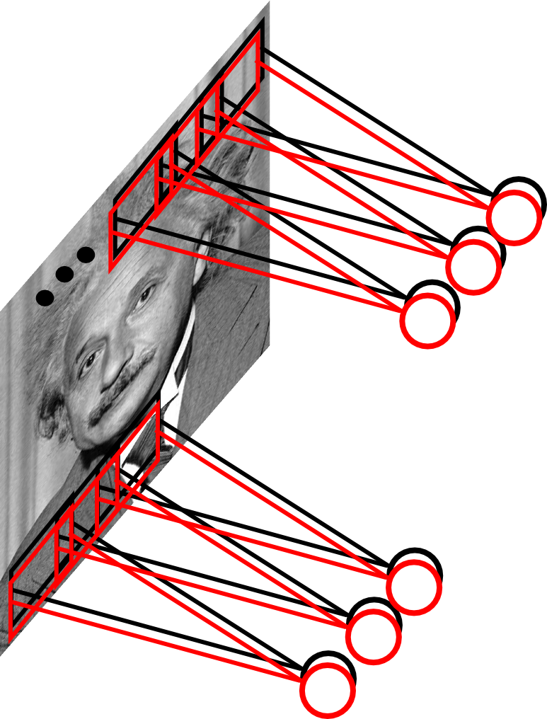
Convolutional Layer
Learn multiple filters.
E.g.: 200x200 image
100 Filters
Filter size: 10x10
10K parameters
Slide Credit: Marc'Aurelio Ranzato

Slide 29
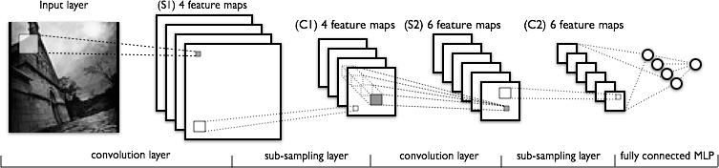
Convolutional Nets
a
Image Credit: Yann LeCun, Kevin Murphy

Slide 30
Convolutional Layer
output feature map
input feature map
kernel
Conv.
layer
Slide Credit: Marc'Aurelio Ranzato

Slide 31
Convolutional Layer
output feature map
input feature map
kernel
Slide Credit: Marc'Aurelio Ranzato

Slide 32
Convolutional Layer
output feature map
input feature map
kernel
Slide Credit: Marc'Aurelio Ranzato

Slide 33
Convolutional Layer
Question: What is the size of the output? What's the computational cost?
Slide Credit: Marc'Aurelio Ranzato

Slide 34
Size of an activation map
Image of 32x32x3
Filter of 5x5x3
activation map
32
28
Apply convolution in all locations
32
28
3
1

Slide 35
Size of an activation map
7
Image of 7x7 pixels (without depth)
Filter of size 3x3
7

Slide 36
Size of an activation map
7
Image of 7x7 pixels (without depth)
Filter of size 3x3
7

Slide 37
Size of an activation map
7
Image of 7x7 pixels (without depth)
Filter of size 3x3
7

Slide 38
Size of an activation map
7
Image of 7x7 pixels (without depth)
Filter of size 3x3
7

Slide 39
Size of an activation map
7
Image of 7x7 pixels (without depth)
Filter of size 3x3
=> Output of 5x5
7

Slide 40
Size of an activation map
7
Image of 7x7 pixels (without depth)
Filter of size 3x3 with stride 2
7

Slide 41
Size of an activation map
7
Image of 7x7 pixels (without depth)
Filter of size 3x3 with stride 2
7

Slide 42
Size of an activation map
7
Image of 7x7 pixels (without depth)
Filter of size 3x3 with stride 2
=> Output of 3x3
7

Slide 43
Size of an activation map
7
Image of 7x7 pixels (without depth)
Filter of size 3x3 with stride 3?
7
It does not fit!
We cannot apply a 3x3 filter on an image of 7x7 pixels using a stride of 3

Slide 44
Size of an activation map
N
Size of the activation map:
(N - F) / stride + 1
e.g. N = 7, F = 3:
stride 1 => (7 - 3)/1 + 1 = 5
stride 2 => (7 - 3)/2 + 1 = 3
stride 3 => (7 - 3)/3 + 1 = 2.33 :(
F
N
F

Slide 45
Multiple convolutional layers…
If we apply convolution with 5x5 filters repeatedly on an input of size 32x32, the volume is gradually reduced (32 => 28 => 24 ...)
Reducing to volume too fast does not produce optimal results
32
28
24
….
CONV,
ReLU
e.g. 6 filters of 5x5x3
CONV,
ReLU
e.g. 10 filters of 5x5x6
CONV,
ReLU
32
28
24
3
6
10

Slide 46
Size of an activation map
In practice: we add zero-padding to the image
0 | 0 | 0 | 0 | 0 | 0
0
0
0
0
e.g. image of 7x7
filter of 3x3, with stride 1
padding of 1 pixel with value 0
Q: How does the activation look?
=> Output of 7x7
In general, we use convolutional layers with stride 1, filters of size FxF, and padding of size (F-1)/2. (this preserves the size of the input image / activation map)
e.g. F = 3 => padding of 1 pixel (value 0)
F = 5 => padding of 2 pixels (value 0)
F = 7 => padding of 3 pixels (value 0)

Slide 47
Example: Size of the output volume
Input volume: 32x32x3
10 filters of 5x5 with stride 1, padding 2
What is the size of the output volume?

Slide 48
Example: Size of the output volume
Input volume: 32x32x3
10 filters of 5x5 with stride 1, padding 2
Size of the output volume:
(32+2*2-5)/1+1 = 32,
so the volume is 32x32x10

Slide 49
Example: Number of parameters
Input volume: 32x32x3
10 filters of 5x5 with stride 1, padding 2
What is the number of parameters of this layer?

Slide 50
Example: Number of parameters
Input volume: 32x32x3
10 filters of 5x5 with stride 1, padding 2
The number of parameters:
Each filter has 5*5*3 + 1 = 76 parameters (+1 for the bias)
=> 76*10 = 760

Slide 51
Convolutional Layer
Question: What is the size of the output? What's the computational cost?
Answer: It is proportional to the number of filters and depends on the stride. If kernels have size KxK, input has size DxD, stride is 1, and there are M input feature maps and N output feature maps then:
- the input has size M@DxD
- the output has size N@(D-K+1)x(D-K+1)
- the kernels have MxNxKxK coefficients (which have to be learned)
- cost: M*K*K*N*(D-K+1)*(D-K+1)
Slide Credit: Marc'Aurelio Ranzato

Slide 52
Convolutional Layer
Question: How many feature maps? What's the size of the filters?
Slide Credit: Marc'Aurelio Ranzato

Slide 53
A convolutional layer
A convolutional layer is composed of multiple filters (e.g. 6)
activation maps
32
28
Convolutional layer
32
28
3
6
We concatenate the activation maps in order to obtain a new “image” of size 28x28x6

Slide 54
A convolutional net
In essence, a convolutional neural network (CNN or ConvNet) is composed of a sequence of convolutional layers, interlaced with activation functions
32
28
24
….
CONV,
ReLU
e.g. 6 filters of 5x5x3
CONV,
ReLU
e.g. 10 filters of 5x5x6
CONV,
ReLU
32
28
24
3
6
10

Slide 55
Convolutional Layer
Question: How many feature maps? What's the size of the filters?
Answer: Usually, there are more output feature maps than input feature maps. Convolutional layers can increase the number of hidden units by big factors (and are expensive to compute).
The size of the filters has to match the size/scale of the patterns we want to detect (task dependent).
Slide Credit: Marc'Aurelio Ranzato

Slide 56
It makes sense to use 1x1 filters
1x1 convolutions
with 32 filters
56
56
(each filter is of size 1x1x64 and computes the dot product depthwise)
56
56
64
32

Slide 57
Key Ideas
A standard neural net applied to images:
- scales quadratically with the size of the input
- does not leverage stationarity
Solution:
- connect each hidden unit to a small patch of the input
- share the weight across space
This is called: convolutional layer.
A network with convolutional layers is called convolutional network.
LeCun et al. “Gradient-based learning applied to document recognition” IEEE 1998
Slide Credit: Marc'Aurelio Ranzato

Slide 58
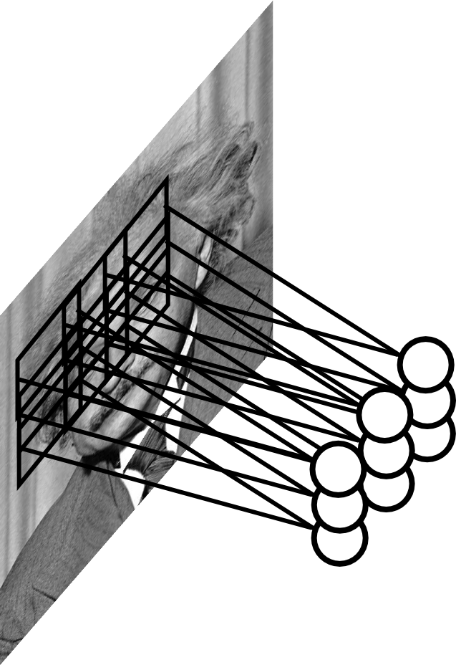
Pooling Layer
Let us assume filter is an “eye” detector.
Q.: how can we make the detection robust to the exact location of the eye?
Slide Credit: Marc'Aurelio Ranzato

Slide 59
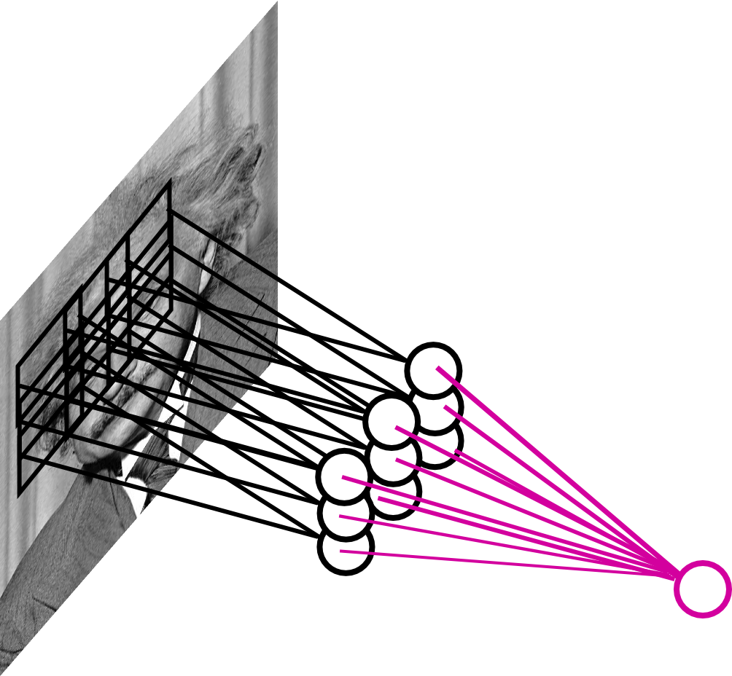
Pooling Layer
By “pooling” (e.g., taking max) filter
responses at different locations we gain robustness to the exact spatial location of features.
Slide Credit: Marc'Aurelio Ranzato

Slide 60
Pooling Layer: Examples
Max-pooling:
Average-pooling:
L2-pooling:
Slide Credit: Marc'Aurelio Ranzato

Slide 61

Pooling Layer
Reduces the spatial size of the representation, allowing optimal use of resources
Operates on each activation map individually:

Slide 62
MAX Pooling
One activation map
1 | 1 | 2 | 4
5 | 6 | 7 | 8
3 | 2 | 1 | 0
1 | 2 | 3 | 4
x
max pooling with 2x2 filters and stride 2
6 | 8
3 | 4
y

Slide 63
Pooling Layer
Question: What is the size of the output? What's the computational cost?
Answer: The size of the output depends on the stride between the pools. For instance, if pools do not overlap and have size KxK, and the input has size DxD with M input feature maps, then:
- output is M@(D/K)x(D/K)
- the computational cost is proportional to the size of the input (negligible compared to a convolutional layer)
Slide Credit: Marc'Aurelio Ranzato

Slide 64
Pooling Layer
Question: How should I set the size of the pools?
Answer: It depends on how much “invariant” or robust to distortions we want the representation to be. It is best to pool slowly (via a few stacks of conv-pooling layers).
Slide Credit: Marc'Aurelio Ranzato

Slide 65




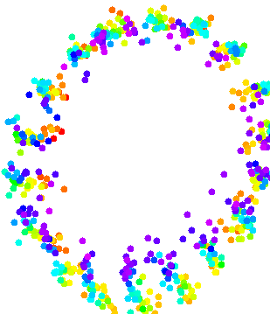













Pooling Layer: Interpretation
Task: detect orientation L/R
Conv layer: linearizes manifold
Slide Credit: Marc'Aurelio Ranzato

Slide 66
Pooling Layer: Interpretation
Task: detect orientation L/R
Conv layer: linearizes manifold
Pooling layer: collapses manifold
Slide Credit: Marc'Aurelio Ranzato

Slide 67
Pooling Layer: Receptive Field Size
Conv.
layer
Pool.
layer
If convolutional filters have size KxK and stride 1, and pooling layer has pools of size PxP, then each unit in the pooling layer depends upon a patch (at the input of the preceding conv. layer) of size: (P+K-1)x(P+K-1)
Slide Credit: Marc'Aurelio Ranzato

Slide 68
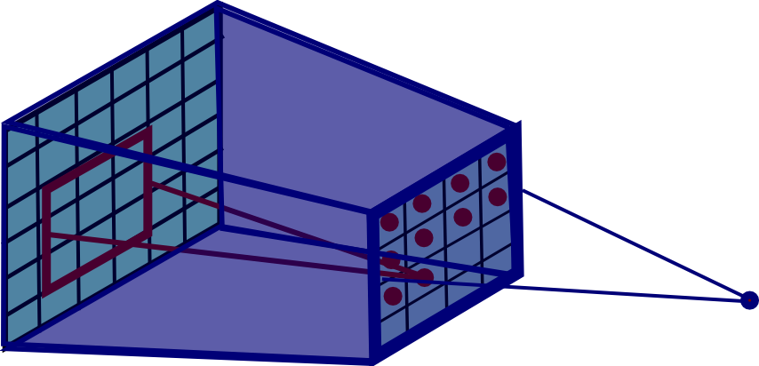
Pooling Layer: Receptive Field Size
Conv.
layer
Pool.
layer
If convolutional filters have size KxK and stride 1, and pooling layer has pools of size PxP, then each unit in the pooling layer depends upon a patch (at the input of the preceding conv. layer) of size: (P+K-1)x(P+K-1)
Slide Credit: Marc'Aurelio Ranzato

Slide 69
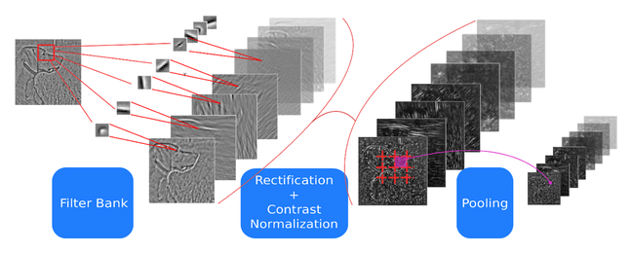
ConvNets: Typical Stage
One stage (zoom)
Convol.
Pooling

Slide 70
ConvNets: Typical Stage
One stage (zoom)
Convol.
Pooling
Conceptually similar to: SIFT, HoG, etc.

Slide 71
Note: after one stage the number of feature maps is usually increased (conv. layer) and the spatial resolution is usually decreased (stride in conv. and pooling layers). Receptive field gets bigger.
Reasons:
- gain invariance to spatial translation (pooling layer)
- increase specificity of features (approaching object specific units)

Slide 72
ConvNets: Typical Architecture
One stage (zoom)
Convol.
Pooling
Whole system
Input Image
Class
Labels
Fully Conn.
Layers
1st stage
2nd stage
3rd stage

Slide 73
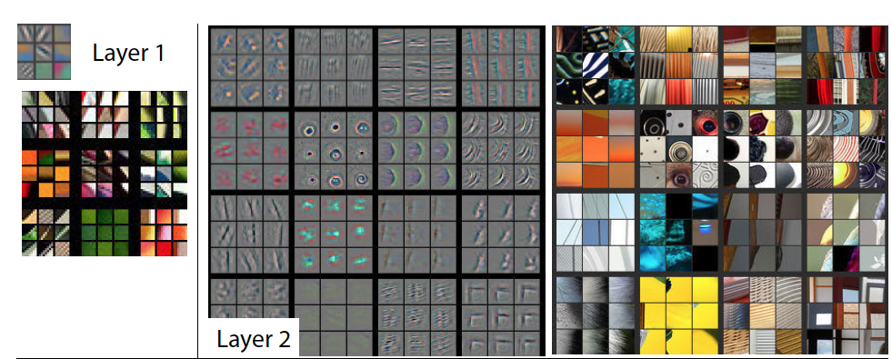
Visualizing Learned Filters
Figure Credit: [Zeiler & Fergus ECCV14]

Slide 74
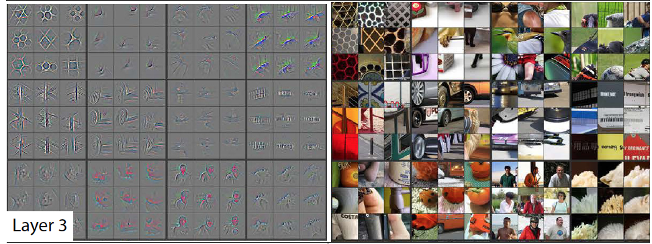
Visualizing Learned Filters
Figure Credit: [Zeiler & Fergus ECCV14]

Slide 75
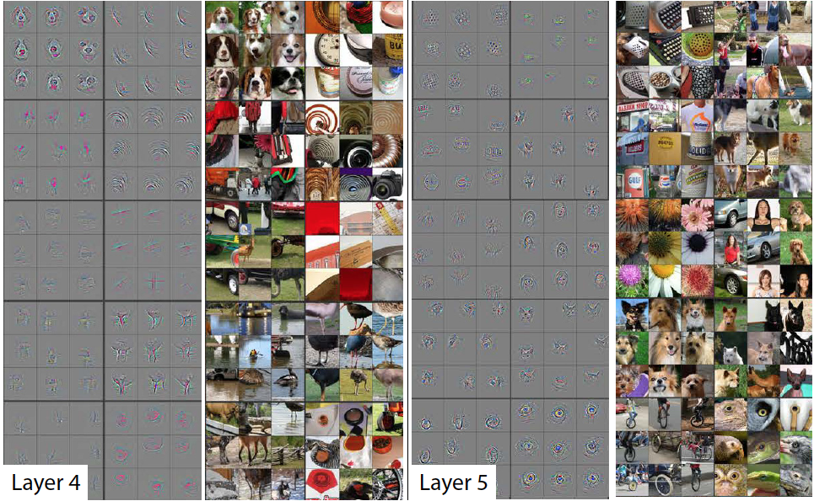
Visualizing Learned Filters
Figure Credit: [Zeiler & Fergus ECCV14]

Slide 76

Case Study: LeNet-5
[LeCun et al., 1998]
Conv filters were 5x5, applied at stride 1
Subsampling (Pooling) layers were 2x2 applied at stride 2,
i.e. architecture is [CONV-POOL-CONV-POOL-CONV-FC]

Slide 77
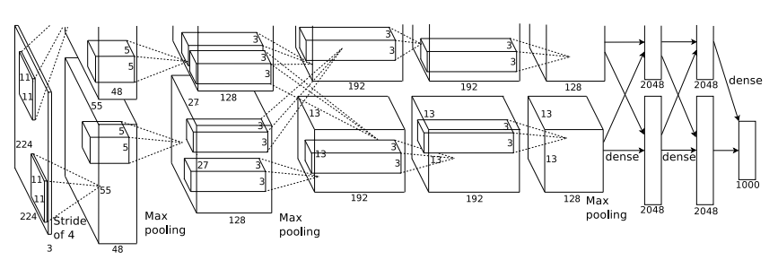
Case Study: AlexNet
[Krizhevsky et al. 2012]
Input: 227x227x3 images
First layer (CONV1): 96 11x11 filters applied at stride 4
=>
Q: what is the output volume size? Hint: (227-11)/4+1 = 55

Slide 78
Case Study: AlexNet
[Krizhevsky et al. 2012]
Input: 227x227x3 images
First layer (CONV1): 96 11x11 filters applied at stride 4
=>
Output volume [55x55x96]
Q: What is the total number of parameters in this layer?

Slide 79
Case Study: AlexNet
[Krizhevsky et al. 2012]
Input: 227x227x3 images
First layer (CONV1): 96 11x11 filters applied at stride 4
=>
Output volume [55x55x96]
Parameters: (11*11*3)*96 = 35K

Slide 80
Case Study: AlexNet
[Krizhevsky et al. 2012]
Input: 227x227x3 images
After CONV1: 55x55x96
Second layer (POOL1): 3x3 filters applied at stride 2
=>
Q: what is the output volume size? Hint: (55-3)/2+1 = 27

Slide 81
Case Study: AlexNet
[Krizhevsky et al. 2012]
Input: 227x227x3 images
After CONV1: 55x55x96
Second layer (POOL1): 3x3 filters applied at stride 2
=>
Output volume: 27x27x96
Q: what is the number of parameters in this layer?

Slide 82
Case Study: AlexNet
[Krizhevsky et al. 2012]
Input: 227x227x3 images
After CONV1: 55x55x96
Second layer (POOL1): 3x3 filters applied at stride 2
=>
Output volume: 27x27x96
Parameters: 0!

Slide 83
Case Study: AlexNet
[Krizhevsky et al. 2012]
Input: 227x227x3 images
After CONV1: 55x55x96
After POOL1: 27x27x96
...

Slide 84
Case Study: AlexNet
Full (simplified) AlexNet architecture:
[227x227x3] INPUT
[55x55x96] CONV1: 96 11x11 filters at stride 4, pad 0
[27x27x96] MAX POOL1: 3x3 filters at stride 2
[27x27x96] NORM1: Normalization layer
[27x27x256] CONV2: 256 5x5 filters at stride 1, pad 2
[13x13x256] MAX POOL2: 3x3 filters at stride 2
[13x13x256] NORM2: Normalization layer
[13x13x384] CONV3: 384 3x3 filters at stride 1, pad 1
[13x13x384] CONV4: 384 3x3 filters at stride 1, pad 1
[13x13x256] CONV5: 256 3x3 filters at stride 1, pad 1
[6x6x256] MAX POOL3: 3x3 filters at stride 2
[4096] FC6: 4096 neurons
[4096] FC7: 4096 neurons
[1000] FC8: 1000 neurons (class scores)
[Krizhevsky et al. 2012]

Slide 85
Case Study: AlexNet
Full (simplified) AlexNet architecture:
[227x227x3] INPUT
[55x55x96] CONV1: 96 11x11 filters at stride 4, pad 0
[27x27x96] MAX POOL1: 3x3 filters at stride 2
[27x27x96] NORM1: Normalization layer
[27x27x256] CONV2: 256 5x5 filters at stride 1, pad 2
[13x13x256] MAX POOL2: 3x3 filters at stride 2
[13x13x256] NORM2: Normalization layer
[13x13x384] CONV3: 384 3x3 filters at stride 1, pad 1
[13x13x384] CONV4: 384 3x3 filters at stride 1, pad 1
[13x13x256] CONV5: 256 3x3 filters at stride 1, pad 1
[6x6x256] MAX POOL3: 3x3 filters at stride 2
[4096] FC6: 4096 neurons
[4096] FC7: 4096 neurons
[1000] FC8: 1000 neurons (class scores)
[Krizhevsky et al. 2012]
Details/Retrospectives:
- first use of ReLU
- used Norm layers (not common anymore)
- heavy data augmentation
- dropout 0.5
- batch size 128
- SGD Momentum 0.9
- Learning rate 1e-2, reduced by 10
manually when val accuracy plateaus
- L2 weight decay 5e-4
- 7 CNN ensemble: 18.2% -> 15.4%

Slide 86
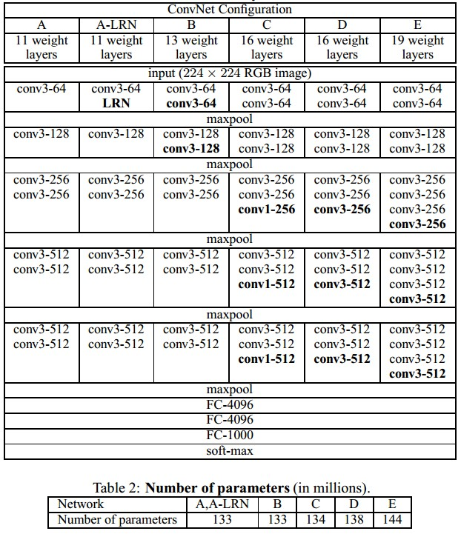
Case Study: VGGNet
Only 3x3 CONV stride 1, pad 1
and 2x2 MAX POOL stride 2
best model
11.2% top 5 error in ILSVRC 2013
=>
7.3% top 5 error
[Simonyan and Zisserman, 2014]

Slide 87
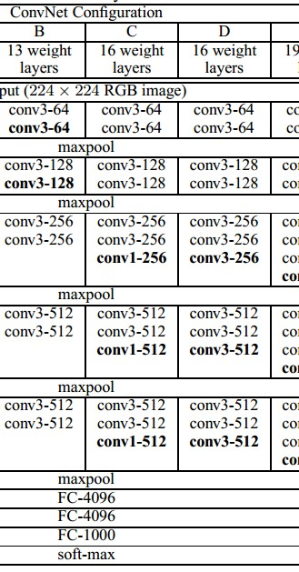
Case Study: VGGNet
(not counting biases)
INPUT: [224x224x3] memory: 224*224*3=150K params: 0
CONV3-64: [224x224x64] memory: 224*224*64=3.2M params: (3*3*3)*64 = 1,728
CONV3-64: [224x224x64] memory: 224*224*64=3.2M params: (3*3*64)*64 = 36,864
POOL2: [112x112x64] memory: 112*112*64=800K params: 0
CONV3-128: [112x112x128] memory: 112*112*128=1.6M params: (3*3*64)*128 = 73,728
CONV3-128: [112x112x128] memory: 112*112*128=1.6M params: (3*3*128)*128 = 147,456
POOL2: [56x56x128] memory: 56*56*128=400K params: 0
CONV3-256: [56x56x256] memory: 56*56*256=800K params: (3*3*128)*256 = 294,912
CONV3-256: [56x56x256] memory: 56*56*256=800K params: (3*3*256)*256 = 589,824
CONV3-256: [56x56x256] memory: 56*56*256=800K params: (3*3*256)*256 = 589,824
POOL2: [28x28x256] memory: 28*28*256=200K params: 0
CONV3-512: [28x28x512] memory: 28*28*512=400K params: (3*3*256)*512 = 1,179,648
CONV3-512: [28x28x512] memory: 28*28*512=400K params: (3*3*512)*512 = 2,359,296
CONV3-512: [28x28x512] memory: 28*28*512=400K params: (3*3*512)*512 = 2,359,296
POOL2: [14x14x512] memory: 14*14*512=100K params: 0
CONV3-512: [14x14x512] memory: 14*14*512=100K params: (3*3*512)*512 = 2,359,296
CONV3-512: [14x14x512] memory: 14*14*512=100K params: (3*3*512)*512 = 2,359,296
CONV3-512: [14x14x512] memory: 14*14*512=100K params: (3*3*512)*512 = 2,359,296
POOL2: [7x7x512] memory: 7*7*512=25K params: 0
FC: [1x1x4096] memory: 4096 params: 7*7*512*4096 = 102,760,448
FC: [1x1x4096] memory: 4096 params: 4096*4096 = 16,777,216
FC: [1x1x1000] memory: 1000 params: 4096*1000 = 4,096,000

Slide 88
Case Study: VGGNet
(not counting biases)
INPUT: [224x224x3] memory: 224*224*3=150K params: 0
CONV3-64: [224x224x64] memory: 224*224*64=3.2M params: (3*3*3)*64 = 1,728
CONV3-64: [224x224x64] memory: 224*224*64=3.2M params: (3*3*64)*64 = 36,864
POOL2: [112x112x64] memory: 112*112*64=800K params: 0
CONV3-128: [112x112x128] memory: 112*112*128=1.6M params: (3*3*64)*128 = 73,728
CONV3-128: [112x112x128] memory: 112*112*128=1.6M params: (3*3*128)*128 = 147,456
POOL2: [56x56x128] memory: 56*56*128=400K params: 0
CONV3-256: [56x56x256] memory: 56*56*256=800K params: (3*3*128)*256 = 294,912
CONV3-256: [56x56x256] memory: 56*56*256=800K params: (3*3*256)*256 = 589,824
CONV3-256: [56x56x256] memory: 56*56*256=800K params: (3*3*256)*256 = 589,824
POOL2: [28x28x256] memory: 28*28*256=200K params: 0
CONV3-512: [28x28x512] memory: 28*28*512=400K params: (3*3*256)*512 = 1,179,648
CONV3-512: [28x28x512] memory: 28*28*512=400K params: (3*3*512)*512 = 2,359,296
CONV3-512: [28x28x512] memory: 28*28*512=400K params: (3*3*512)*512 = 2,359,296
POOL2: [14x14x512] memory: 14*14*512=100K params: 0
CONV3-512: [14x14x512] memory: 14*14*512=100K params: (3*3*512)*512 = 2,359,296
CONV3-512: [14x14x512] memory: 14*14*512=100K params: (3*3*512)*512 = 2,359,296
CONV3-512: [14x14x512] memory: 14*14*512=100K params: (3*3*512)*512 = 2,359,296
POOL2: [7x7x512] memory: 7*7*512=25K params: 0
FC: [1x1x4096] memory: 4096 params: 7*7*512*4096 = 102,760,448
FC: [1x1x4096] memory: 4096 params: 4096*4096 = 16,777,216
FC: [1x1x1000] memory: 1000 params: 4096*1000 = 4,096,000
TOTAL memory: 24M * 4 bytes ~= 93MB / image (only forward! ~*2 for bwd)
TOTAL params: 138M parameters

Slide 89
Case Study: VGGNet
(not counting biases)
INPUT: [224x224x3] memory: 224*224*3=150K params: 0
CONV3-64: [224x224x64] memory: 224*224*64=3.2M params: (3*3*3)*64 = 1,728
CONV3-64: [224x224x64] memory: 224*224*64=3.2M params: (3*3*64)*64 = 36,864
POOL2: [112x112x64] memory: 112*112*64=800K params: 0
CONV3-128: [112x112x128] memory: 112*112*128=1.6M params: (3*3*64)*128 = 73,728
CONV3-128: [112x112x128] memory: 112*112*128=1.6M params: (3*3*128)*128 = 147,456
POOL2: [56x56x128] memory: 56*56*128=400K params: 0
CONV3-256: [56x56x256] memory: 56*56*256=800K params: (3*3*128)*256 = 294,912
CONV3-256: [56x56x256] memory: 56*56*256=800K params: (3*3*256)*256 = 589,824
CONV3-256: [56x56x256] memory: 56*56*256=800K params: (3*3*256)*256 = 589,824
POOL2: [28x28x256] memory: 28*28*256=200K params: 0
CONV3-512: [28x28x512] memory: 28*28*512=400K params: (3*3*256)*512 = 1,179,648
CONV3-512: [28x28x512] memory: 28*28*512=400K params: (3*3*512)*512 = 2,359,296
CONV3-512: [28x28x512] memory: 28*28*512=400K params: (3*3*512)*512 = 2,359,296
POOL2: [14x14x512] memory: 14*14*512=100K params: 0
CONV3-512: [14x14x512] memory: 14*14*512=100K params: (3*3*512)*512 = 2,359,296
CONV3-512: [14x14x512] memory: 14*14*512=100K params: (3*3*512)*512 = 2,359,296
CONV3-512: [14x14x512] memory: 14*14*512=100K params: (3*3*512)*512 = 2,359,296
POOL2: [7x7x512] memory: 7*7*512=25K params: 0
FC: [1x1x4096] memory: 4096 params: 7*7*512*4096 = 102,760,448
FC: [1x1x4096] memory: 4096 params: 4096*4096 = 16,777,216
FC: [1x1x1000] memory: 1000 params: 4096*1000 = 4,096,000
Note:
Most memory is in early CONV
Most params are
in late FC
TOTAL memory: 24M * 4 bytes ~= 93MB / image (only forward! ~*2 for bwd)
TOTAL params: 138M parameters

Slide 90

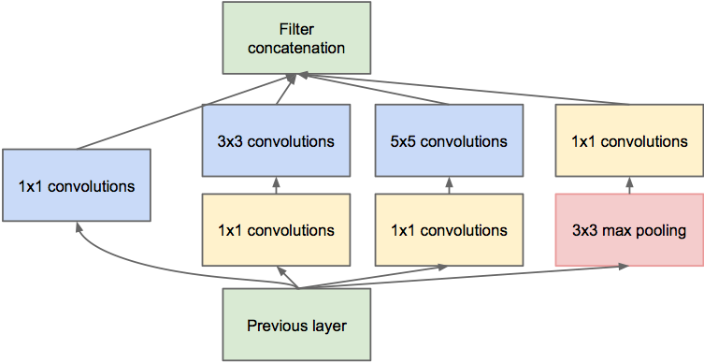
Case Study: GoogLeNet
[Szegedy et al., 2014]
Inception module
ILSVRC 2014 winner (6.7% top 5 error)

Slide 91
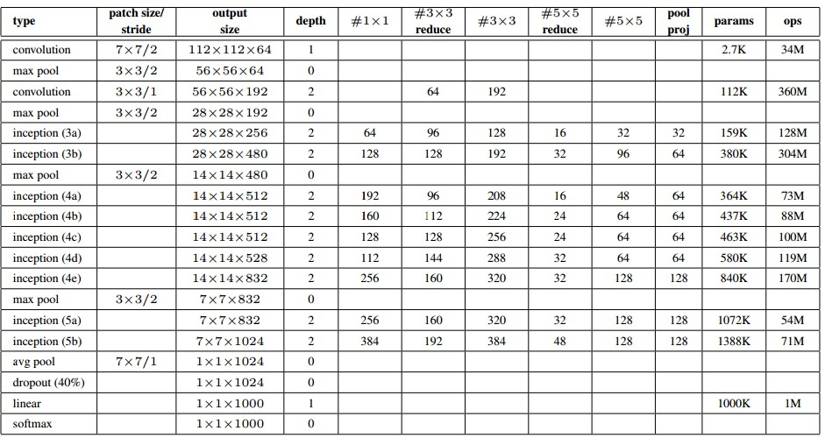
Case Study: GoogLeNet
Fun features:
- Only 5 million params!
(Removes FC layers completely)
Compared to AlexNet:
- 12X less params
- 2x more compute
- 6.67% (vs. 16.4%)

Slide 92
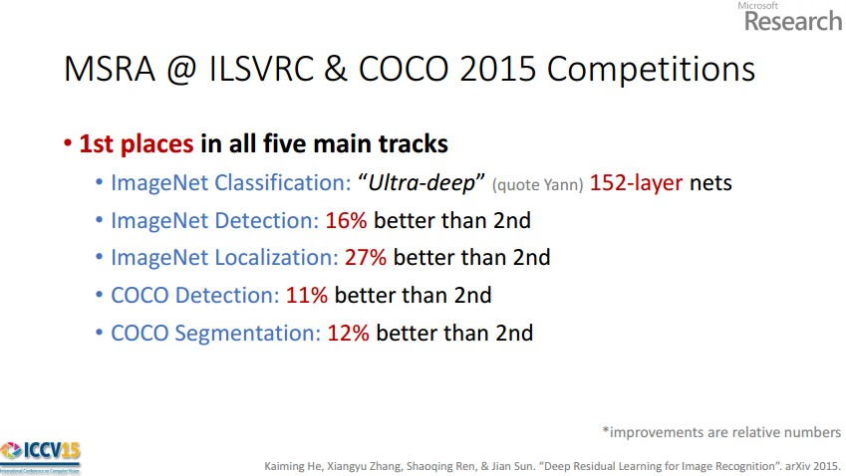
Case Study: ResNet
[He et al., 2015]
ILSVRC 2015 winner (3.6% top 5 error)
Slide from Kaiming He’s recent presentation https://www.youtube.com/watch?v=1PGLj-uKT1w

Slide 93
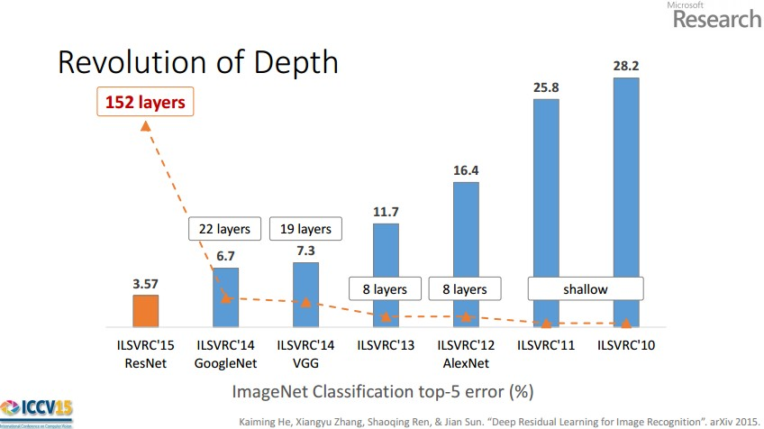
Slide from Kaiming He’s recent presentation

Slide 94
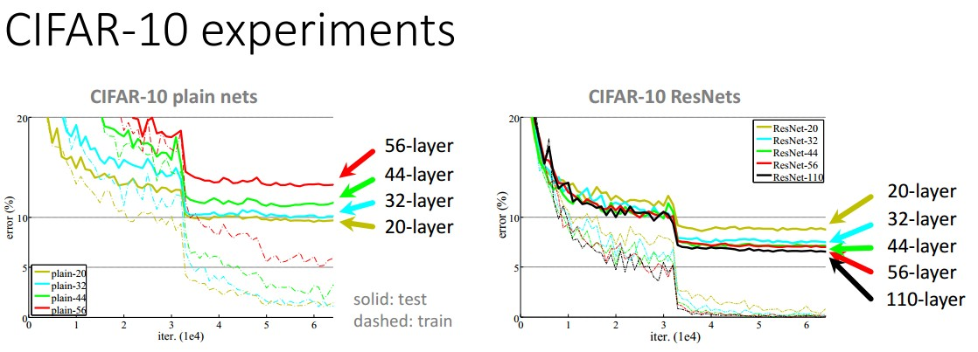

Slide 95
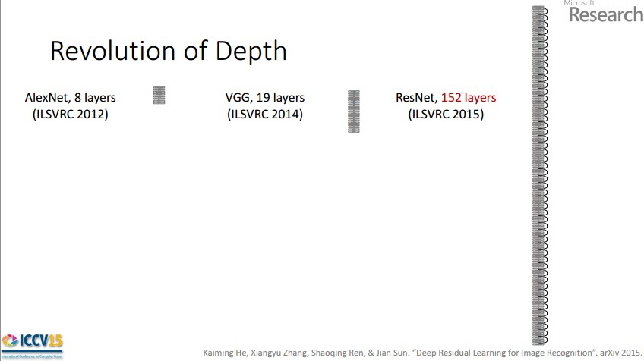
Case Study: ResNet
ILSVRC 2015 winner (3.6% top 5 error)
2-3 weeks of training on 8 GPU machine
at runtime: faster than a VGGNet! (even though it has 8x more layers)
Slide from Kaiming He’s recent presentation

Slide 96
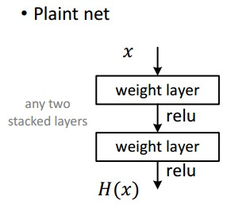
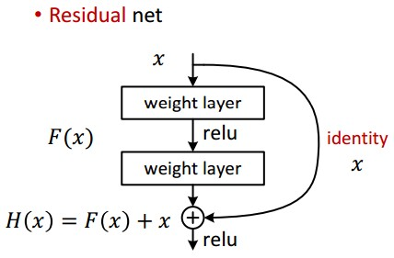
Case Study: ResNet
[He et al., 2015]

Slide 97
Case Study: ResNet
Batch Normalization after every CONV layer
Xavier/2 initialization from He et al.
SGD + Momentum (0.9)
Learning rate: 0.1, divided by 10 when validation error plateaus
Mini-batch size 256
Weight decay of 1e-5
No dropout used

Slide 98
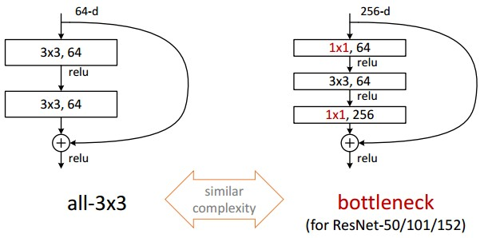
Case Study: ResNet
[He et al., 2015]

Slide 99
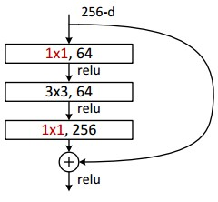
Case Study: ResNet
(this trick is also used in GoogLeNet)

Slide 100
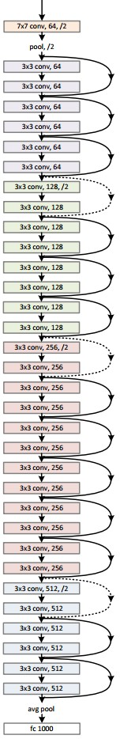
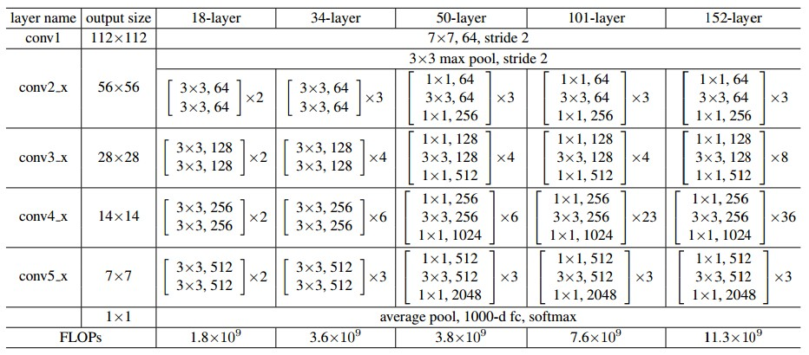
Case Study: ResNet
[He et al., 2015]

Slide 101
Summary
ConvNets stack CONV,POOL,FC layers
Trend towards smaller filters and deeper architectures
Trend towards getting rid of POOL/FC layers (just CONV)
Typical architectures look like
[(CONV-RELU)*N-POOL?]*M-(FC-RELU)*K,SOFTMAX
where N is usually up to ~5, M is large, 0 <= K <= 2.
but recent advances such as ResNet/GoogLeNet challenge this paradigm

Slide 102
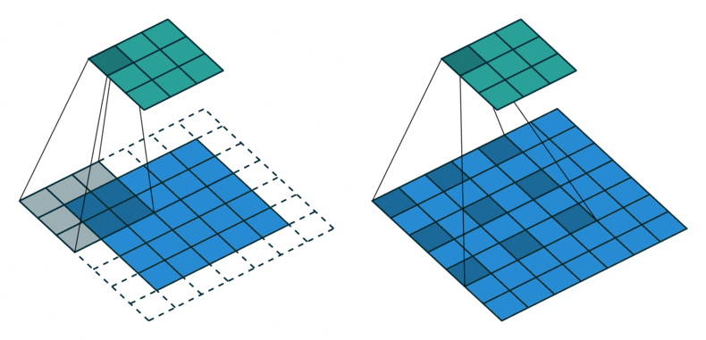
Fancier Convolutions: Dilated
Yu et al. “Multi-Scale Context Aggregation by Dilated Convolutions” ICLR 2016
Slide Credit: Marc'Aurelio Ranzato

Slide 103
Contextual Convolutional Neural Netoworks
IC Duță, MI Georgescu, RT Ionescu
ICCVW 2021

Slide 104
Fancier Convolutions: Dilated
Duță et al. “Contextual Convolutional Neural Networks” ICCVW 2021

Slide 105
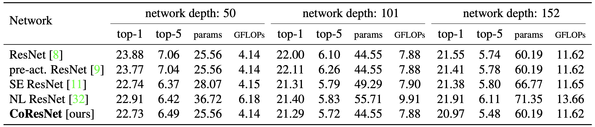
Fancier Convolutions: Dilated
Results on ImageNet:
Duță et al. “Contextual Convolutional Neural Networks” ICCVW 2021
Slide Credit: Marc'Aurelio Ranzato

Slide 106

Fancier Convolutions: Separable
Chollet “Xception: Deep Learning with Depthwise Separable Convolutions” CVPR 2017
Slide Credit: Marc'Aurelio Ranzato

Slide 107

Fancier Architectures: Multi-Modal
Matching
shared representation
CNN
Text Embedding
tiger
Frome et al. “Devise: a deep visual semantic embedding model” NIPS 2013
Slide Credit: Marc'Aurelio Ranzato

Slide 108
Fancier Architectures: Multi-Task
Fully
Conn.
Attr. 1
Fully
Conn.
Attr. 2
image
Conv
Norm
Pool
Conv
Norm
Pool
Conv
Norm
Pool
Conv
Norm
Pool
Fully
Conn.
...
Fully
Conn.
Attr. N
Zhang et al. “PANDA..” CVPR 2014
Slide Credit: Marc'Aurelio Ranzato

Slide 109
Anomaly Detection in Video via Self-Supervised and Multi-Task Learning
MI Georgescu, A Bărbălău, RT Ionescu,
FS Khan, M Popescu, M Shah
CVPR 2021

Slide 110

Notes:
This is our model composed of a shared 3D CNN and 4 heads, one for each proxy task. First, we detect the objects in video using YoloV3. Then we pass each object-centric temporal sequence through our model to predict the output of the proxy tasks. The Yolo-v3 and Resnet-50 models are pre-trained while our model is trained from scratch on each data set.

Slide 111

Neural architectures
Notes:
Our architecture is composed of a shared CNN and four independent prediction heads. The shared CNN uses 3D convolutions, while the heads use 2D convolutions and dense layers.
When we started to jointly optimizing our model on multiple proxy tasks, we observed the need to increase the width and depth of our neural network to accommodate for the increased complexity of the multi-task learning problem. We therefore employ a set of four 3D CNNs, considering all possible combinations of shallow, deep, narrow and wide architectures.

Slide 112

Joint loss
Our 3D CNN model is trained by jointly optimizing it on the four proxy tasks, using the following joint loss function:
$$Ltotal=L\text{T}\text{1}+L\text{T}\text{2}+L\text{T}\text{3}+λL\text{T}\text{4}$$
where $λ∊(0, 1]$is a weight that regulates the importance of the knowledge distillation task.
Notes:
Our 3D CNN model is trained by jointly optimizing it on the four proxy tasks.
We empirically observed that LT4 has a higher magnitude than the other loss functions, dominating the joint loss without a regularization term. In our experiments, we fine-tune λ with respect to the validation results of the joint loss on the proxy tasks.

Slide 113
Fancier Architectures: Generic DAG
Any DAG of differentialble modules is allowed!
Slide Credit: Marc'Aurelio Ranzato

